Slide 1
INF 551 Project Proposal
Project Meta Gutenberg
Chenghao Mou Han Zhang
September 9, 2018

Slide 2
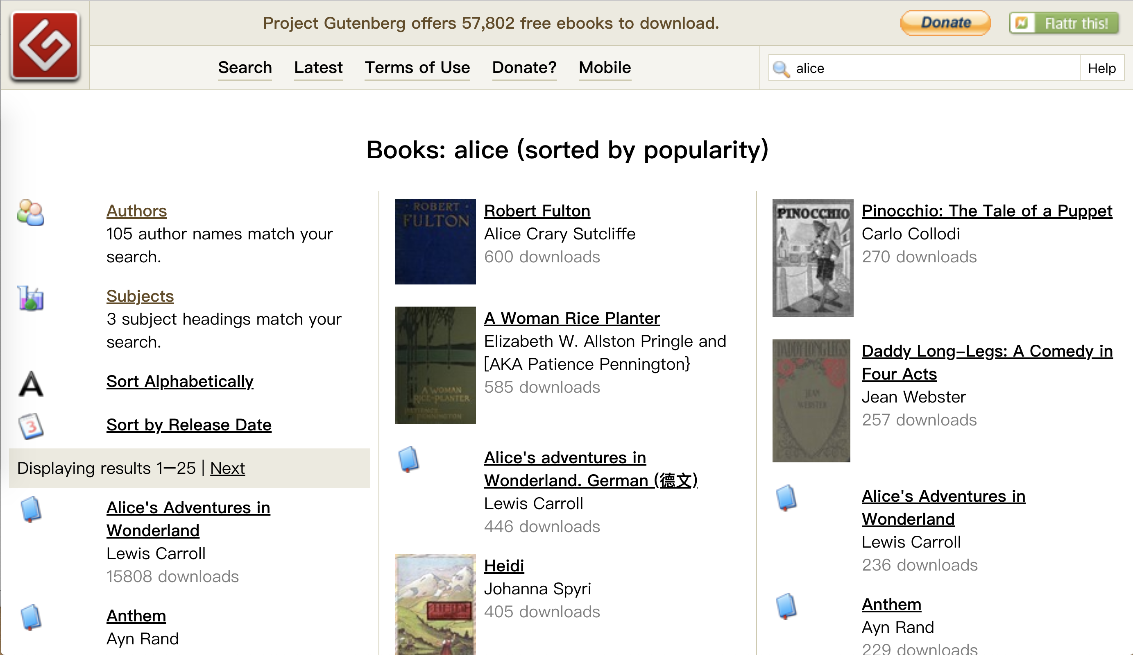
Project Gutenberg website | 2

Slide 3
Idea
Functionality
User-friendly Meta Search in all PDF, EPUB files from Project Gutenberg and other free PDF books.
Data Source
Mainly from Project GutenBerg
Idea | 3

Slide 4
PDF/EPUB Meta Information
Creator/Author
Publisher
Publish Date
Identifiers(UUID/ISBN)
Language
Subject
Title/Name
Keywords
PDF Version/EPUB Version
TOC(Table of Contents)
Meta Information | 4

Slide 5
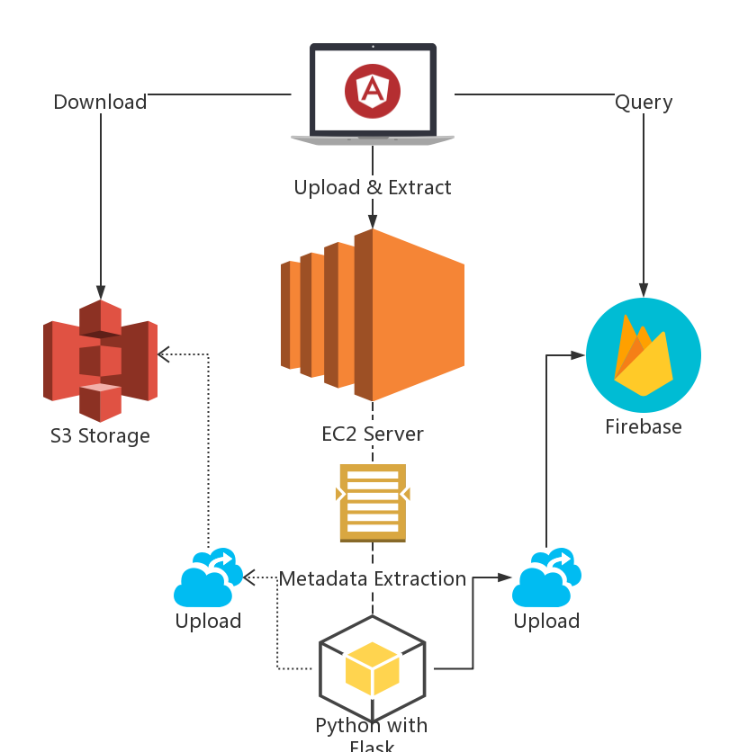
Architecture
Architecture | 5

Slide 6
Major Dependencies
Oletools
PyPDF
Epub-meta
Flask
Firebase
AngularJS/Jquery/Fuse
Major Dependencies | 6

Slide 7
Prototype
Currently supports
File formats: MS, PDF
Upload and Extraction
Server File Storage
Firebase Synchronization
Local Fuzzy Search
Prototype | 7

Slide 8
Team
Members
Chenghao Mou
Front-end implementation and query requests
Han Zhang
Back-end applications, including uploading and extraction
Team | 8

Slide 9
Milestones
4 weeks : fully functional prototype 9.30
2 weeks : UX and UI improvement 10.14
2 weeks : Documentation 10.29
1 month: Extra functionalities and UI 11.26
Milestone | 8

